Slide 1

MinneMUDAC: Big Brothers Big Sisters
GREEN
Metric Masters
Devendra Adhikari, Wyatt Clausen, Spencer Connolly,
Rei Onishi, Pramudya Wicaksono
Notes:
Rei

Slide 2
01
Match Success
02
Match Analysis
TABLE OF CONTENTS
03
Sentiment Analysis
04
Prediction Model
05
Intervention Strategies
Notes:
Rei

Slide 3
01
Match Success
Notes:
Rei

Slide 4
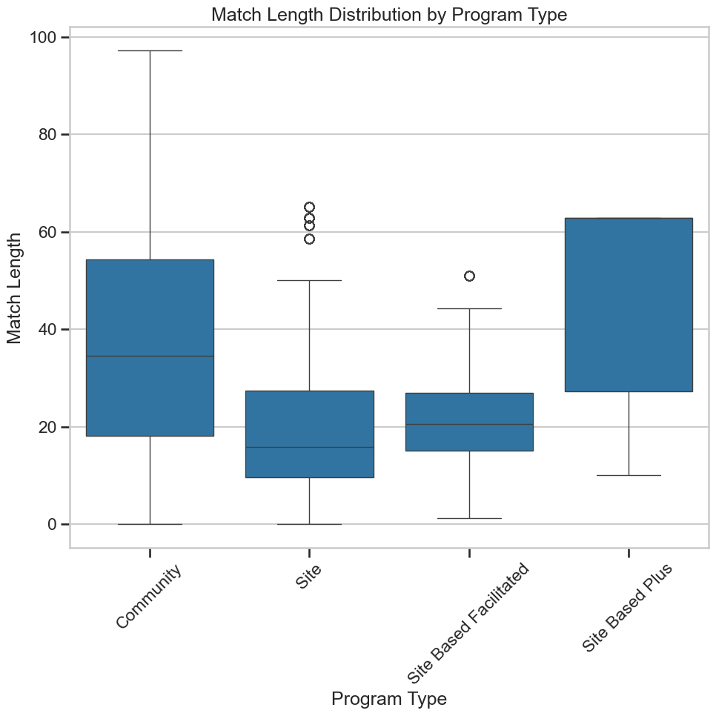
Factors that Drive Match Success
Community Matches seem to be consistently most successful.
Notes:
Rei Summary Statistics of Match Length by Program Type:
Program Type count mean median min max std 0 Community 32099 38.57 34.5 0.0 97.2 23.95
1 Site 5125 19.53 15.9 0.0 65.1 13.00
2 Site Based Facilitated 2067 21.53 20.6 1.2 51.0 9.73
3 Site Based Plus 54 45.10 62.8 10.1 62.8 21.42

Slide 5
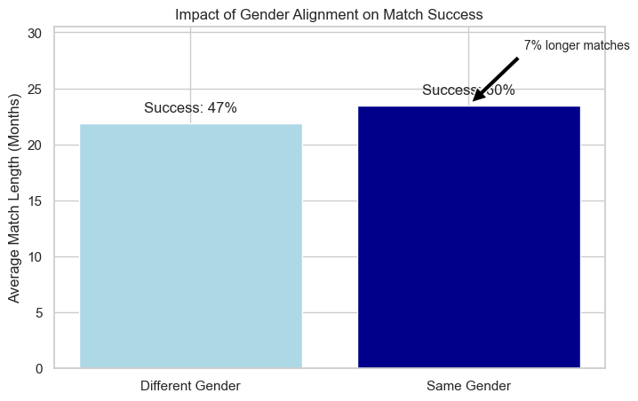
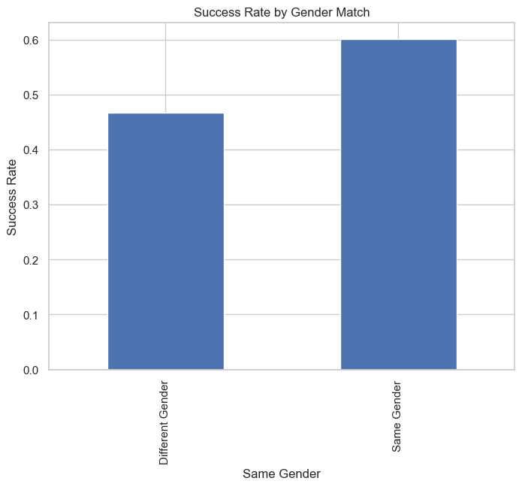
Factors that Drive Match Success Cont.
Gender alignment increases longer matches by 7%
Gender alignment increases match success by 18-23%
Notes:
Rei

Slide 6
02
Match Analysis
Notes:
Pram

Slide 7
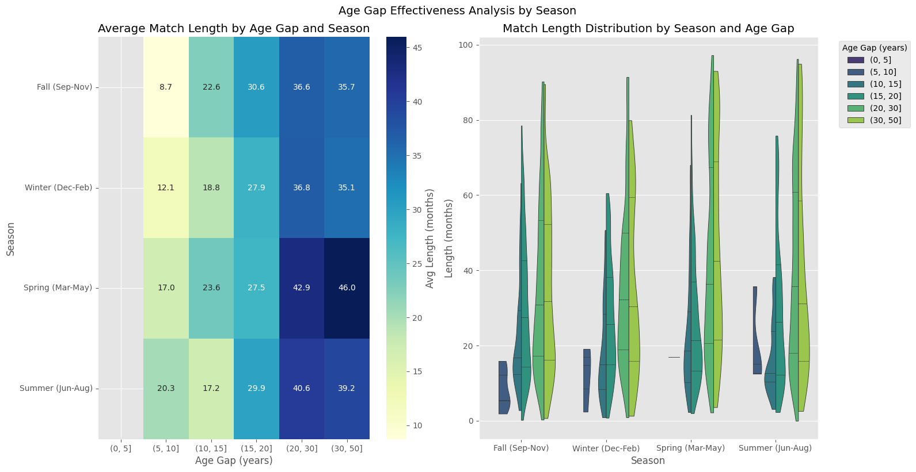
Age Gap Effectiveness Analysis by Season Start
Notes:
Pram

Slide 8
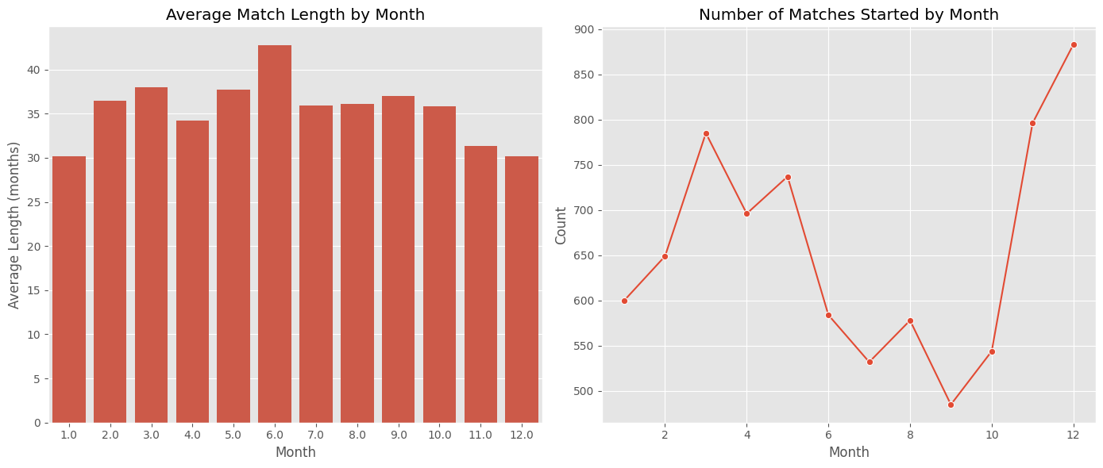
Match Length & Month Correlation

Slide 9
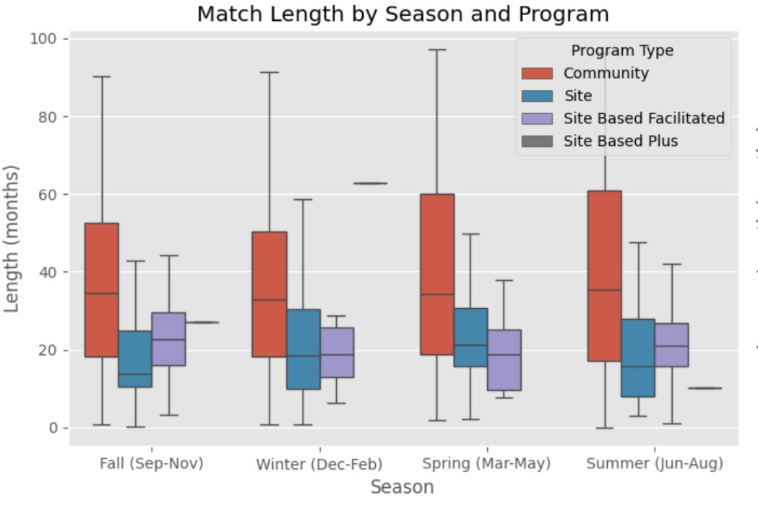
Match Length & Season Correlation

Slide 10
03
Sentiment Analysis
Notes:
Spencer
SCRIPT
<><><><><><><><><>
Now we'll discuss some insights we found from our sentiment analysis (5 seconds)
<><><><><><><><><>
---
Can you elaborate on how the sentiment analysis was performed? What Python libraries were used? How were those Python libraries implemented? I'll help you understand how sentiment analysis was performed in the provided Python code. I'll break down the process step by step to explain the libraries used and their implementation.
Sentiment Analysis Implementation in the Code
1. Libraries Used for Sentiment Analysis
The code uses the Hugging Face Transformers library, which provides pre-trained NLP models. Specifically, it imports the pipeline module:
from transformers import pipeline
2. Loading the Pre-trained Sentiment Analysis Model
The code initializes a sentiment analysis pipeline using a multilingual BERT model:
sentiment_analyzer = pipeline("sentiment-analysis", model="nlptown/bert-base-multilingual-uncased-sentiment")
This creates a pipeline that uses the "nlptown/bert-base-multilingual-uncased-sentiment" model, which is designed for sentiment analysis across multiple languages. The model outputs sentiment scores on a 5-star rating scale (1-5 stars).
3. Text Pre-processing Before Sentiment Analysis
Before applying sentiment analysis, the code performs several preprocessing steps:
a) Text truncation to handle long texts:
def truncate_text(text, max_tokens=512): """Truncates text to a maximum number of tokens.""" words = text.split() if len(words) > max_tokens: return ' '.join(words[:max_tokens]) return text
This function ensures that the text is within the token limit that the model can process.
b) For longer texts, the code first applies summarization before sentiment analysis:
if len(text.split()) > 200: summary = summarizer(text, max_length=300, min_length=200, do_sample=False) summary_text = summary[0]['summary_text'] else: summary = text
The summarization is done using another Hugging Face model:
summarizer = pipeline("summarization", model="facebook/bart-large-cnn")

Slide 11
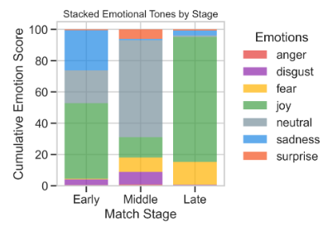
Emotional Tones in Match Notes
Notes:
Spencer
SCRIPT
<><><><><><><><>
Sentiment analysis allows us to utilize the match notes portion of the training data by extracting numerical data from text that allows computers to better understand the emotion behind it. (10 seconds)
The attached visualization is a bird's-eye view of the emotions expressed by match notes at various points of the match cycle. (10 seconds)
<><><><><><><><>
MODEL USED: j-hartmann/emotion-english-distilroberta-base) which offers 7 basic emotions
https://dataloop.ai/library/model/j-hartmann_emotion-english-distilroberta-base/
"This fine-tuned checkpoint of DistilRoBERTa-base is efficient and accurate, with an evaluation accuracy of 66% - significantly higher than the random-chance baseline." How the Emotion Model Works
The j-hartmann/emotion-english-distilroberta-base model analyzes text and assigns scores across all seven emotion categories simultaneously:
Each note receives scores for all 7 emotions (anger, disgust, fear, joy, neutral, sadness, surprise)
The scores represent probabilities and sum to 100%
The model processes each note as a whole, not sentence by sentence
The dominant emotion is the one with the highest score
<><><><><><><><><><>
EMOTIONAL TONES
<><><><><><><><><><>
Emotional tones in the match support notes can give us a lot of great insights
<><><><><><><><><><>
Visualizations created using a random sample size of 100 from the notes in order to save on computational resources.
---
From our model, we observed less confidence in as matches progressed. However, Lower confidence could suggest:
Mixed emotional signals in the communication
More factual/procedural content rather than emotional content
Complex situations that don't fit neatly into positive/negative categories

Slide 12
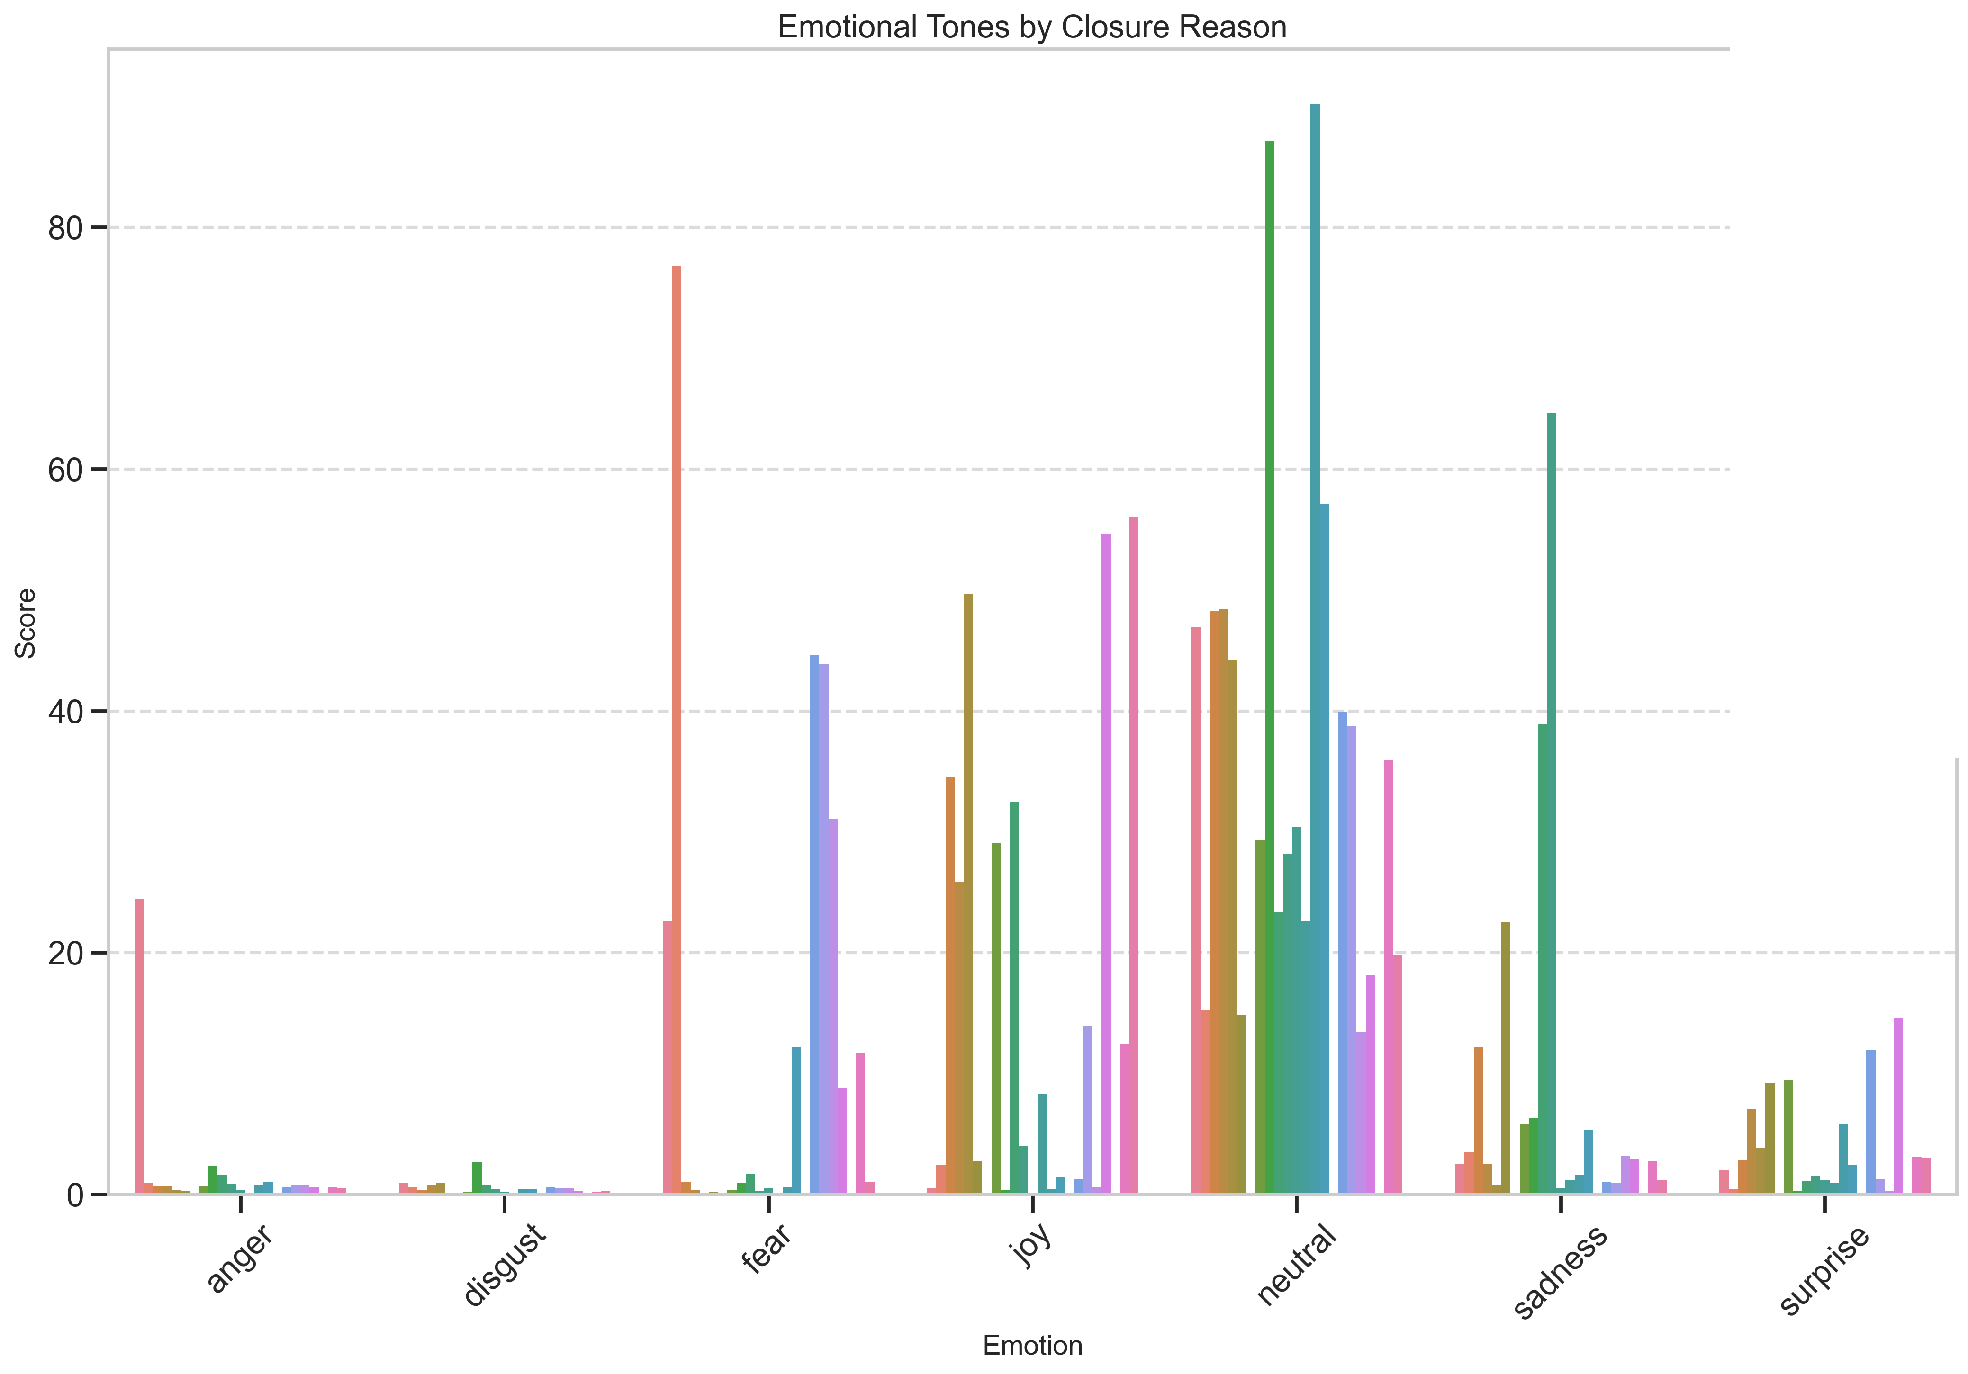
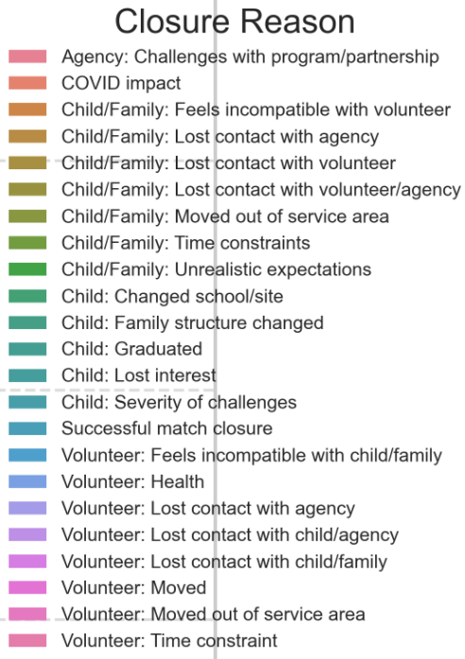
Emotional Tones by Closure Reason
Notes:
Spencer
SCRIPT
<><><><><><><><>
All match closure reasons are uniquely associated with emotions as can be seen in this colorful bar graph. (9 seconds)
<><><><><><><><>

Slide 13
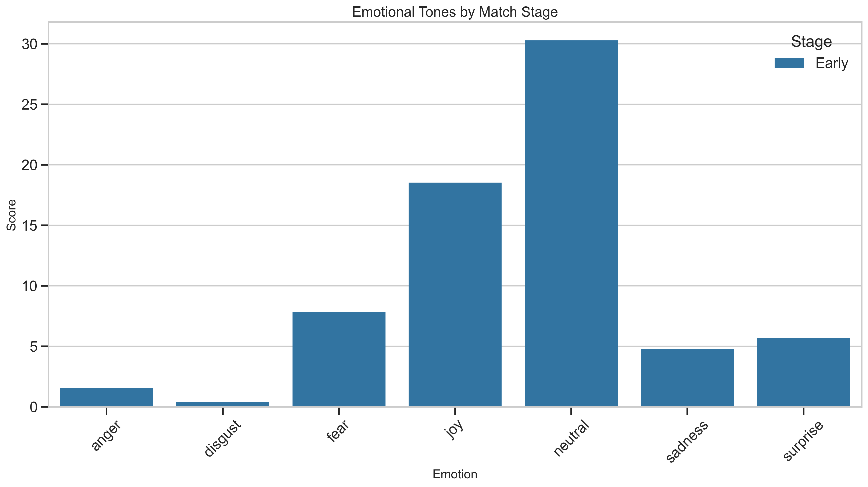
Emotional Tones by Call
Emotional Tones
Notes:
Spencer
SCRIPT
<><><><><><><><>
Here's a version that's easier to look at. (4 seconds)
As we can see, the negative emotions which are most common are anger, fear, and sadness. (7 seconds)
For diagnosing intervention strategies, we will want to pay attention to these emotions the most. (7 seconds)
<><><><><><><><>
Most rows have notes. Only 3.7% of rows in the training dataset are missing them.
Angry notes often don't qualify for having an emotional profile because angry writers write a lot. This overloads the model in the match support notes' raw form.

Slide 14
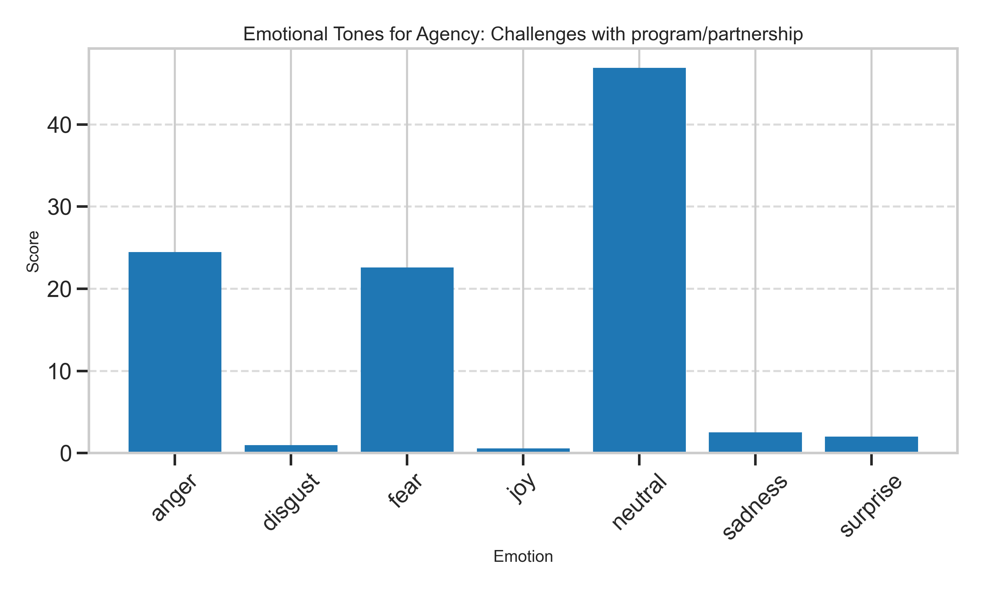
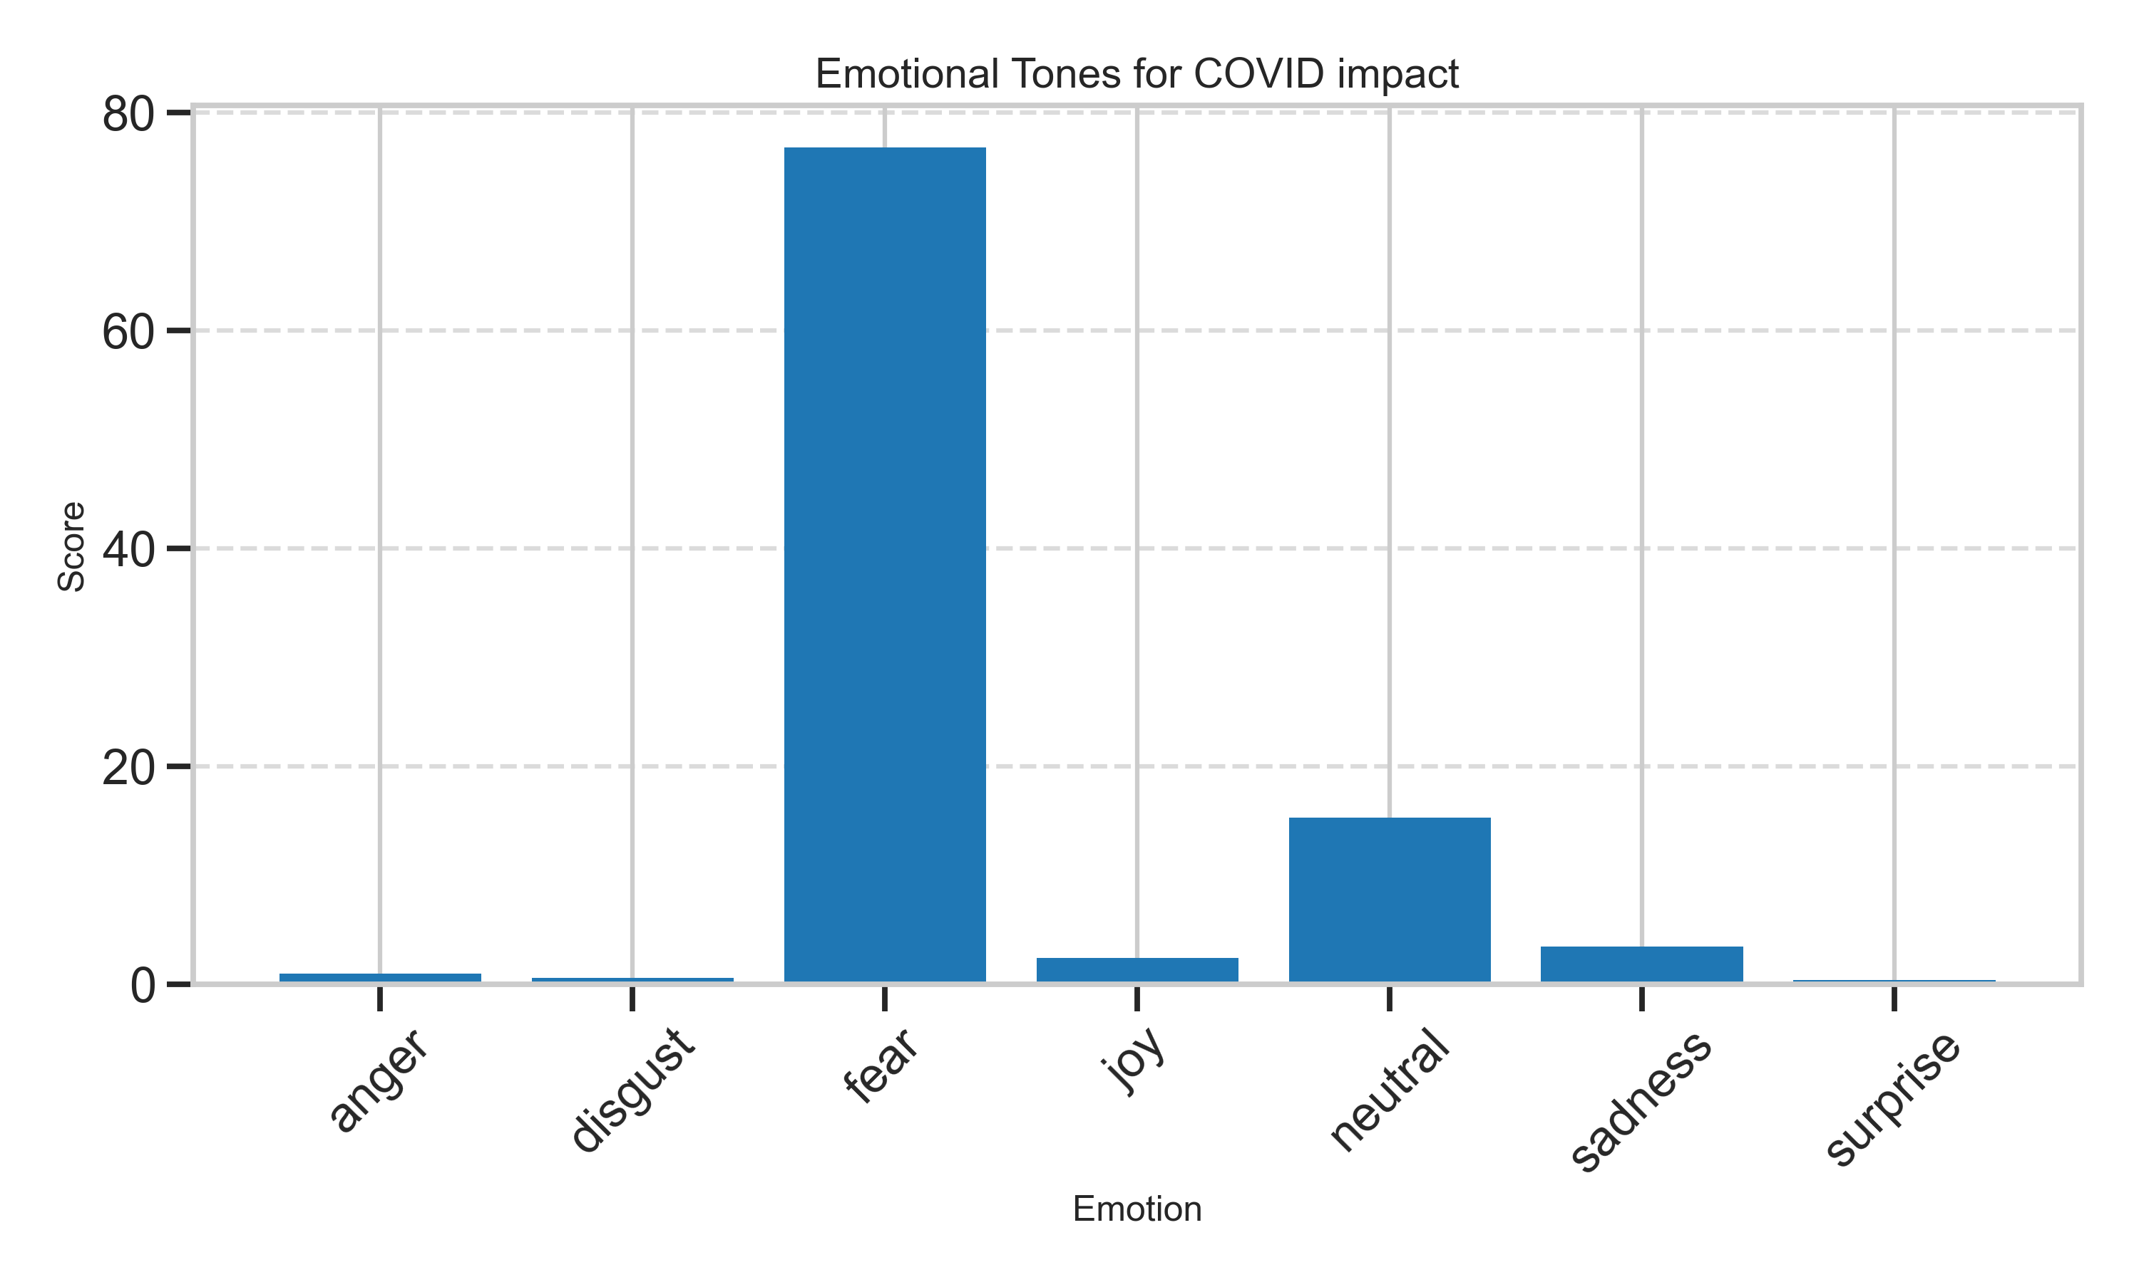
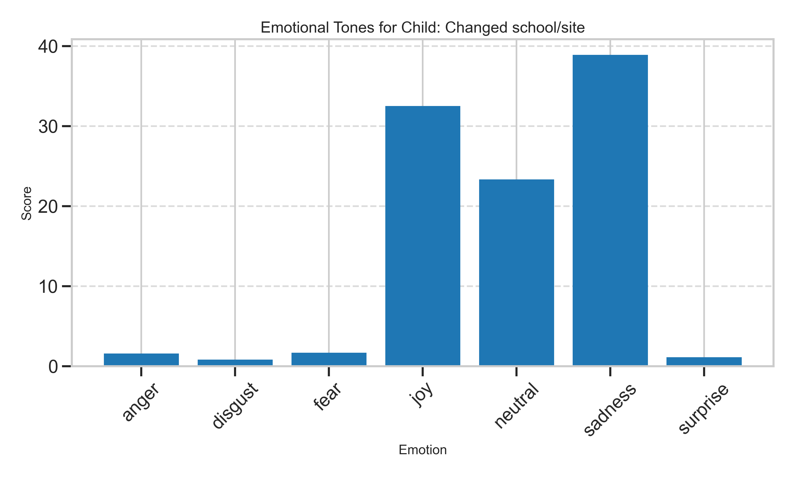
Emotional Tones by Closure Reason
Notes:
Spencer
SCRIPT
<><><><><><><><>
Closure reasons that embody these emotions can be found here—Challenges with the program or partnership (anger and fear), COVID impact (fear), and a child changing school or site (sadness). (17 seconds)
A helpful intervention strategy for these scenarios could come in the form of maximizing communication channels. (7 seconds)
This would increase the chances that parties have multiple options to express their frustrations and that contact can be maintained in moments of crisis. (8 seconds)
It's good to mention, however, that applying this in this positive direction could be great for maximizing good emotion rather than simply minimizing bad emotion. (10 seconds)
<><><><><><><><>
--- Could be a good idea to re-color these graphs based on the emotion they're representing (red for anger, purple for fear, dark blue for sadness ---
Most rows have notes. Only 3.7% of rows in the training dataset are missing them.
Angry notes often don't qualify for having an emotional profile because angry writers write a lot. This overloads the model in the match support notes' raw form.

Slide 15
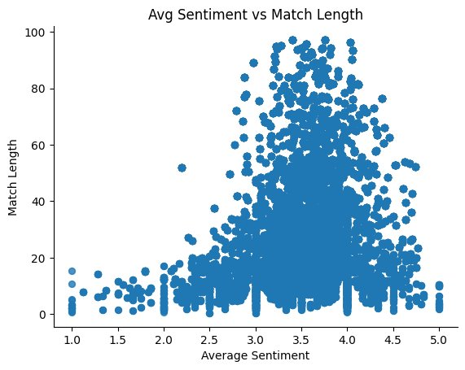
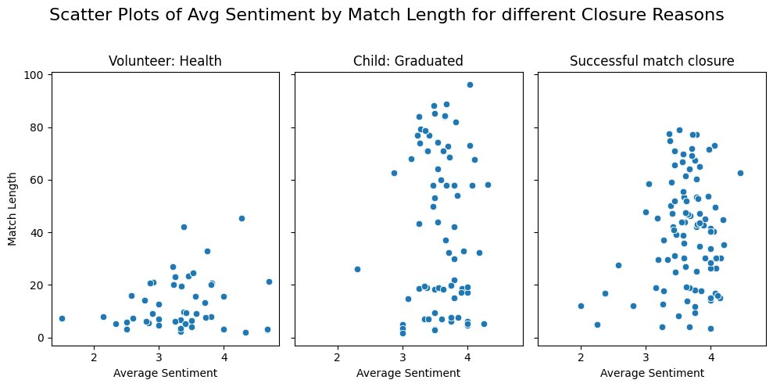
Average Sentiment vs. Match Length by Closure Reason
Matches with a little who graduated from school have higher match length and positive sentiment
Successful match closures show positive sentiment and longer match length
Negative sentiments have short match lengths, with slightly positive average sentiment
Notes:
Devendra
Why used Bert for sentiment analysis?
Pretrained on large, diverse datasets, making it effective for understanding context.
BERT strikes a good balance between performance and resource consumption, making it effective for most tasks.
How?
Leveraged the Hugging Face Transformers library, which provides pre-trained BERT models for various tasks, including sentiment analysis.
Script: We analyzed sentiments from match support call notes. Each dot shows a match—average sentiment on the x-axis, match length on the y-axis. Most matches are neutral, but those that ended due to graduation or were tagged successful show longer match lengths and more positive sentiment. Matches with negative sentiment tend to be shorter—which makes sense.

Slide 16
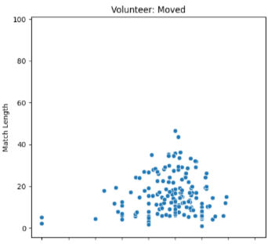
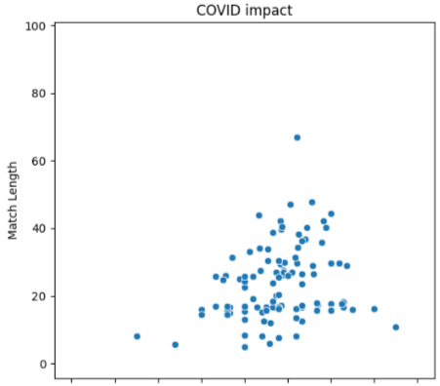
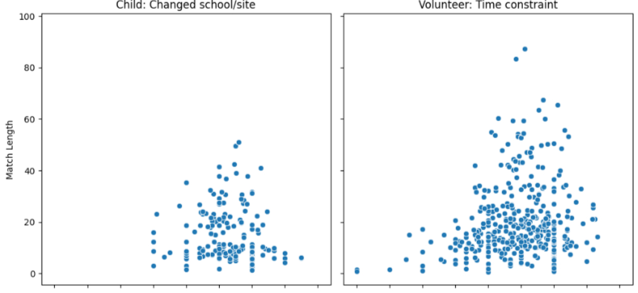
COVID, Relocation, Time Constraint
Notes:
Devendra
Script: Across all three plots, one common factor is limited in-person interaction—mainly due to time constraints, relocation or COVID. Even with neutral sentiment, limited interactions lead to shorter match lengths. We believe introducing online engagement options could help increase match length.

Slide 17
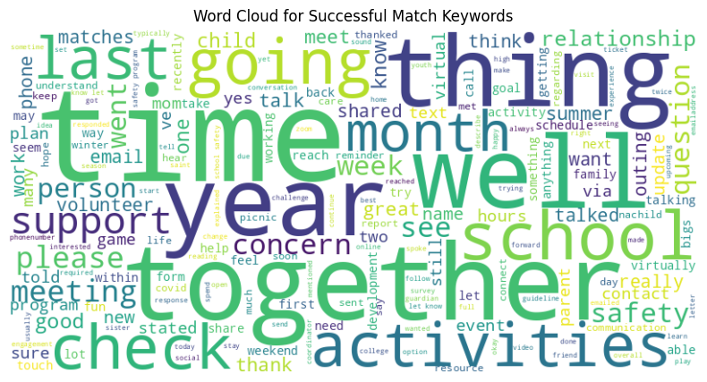
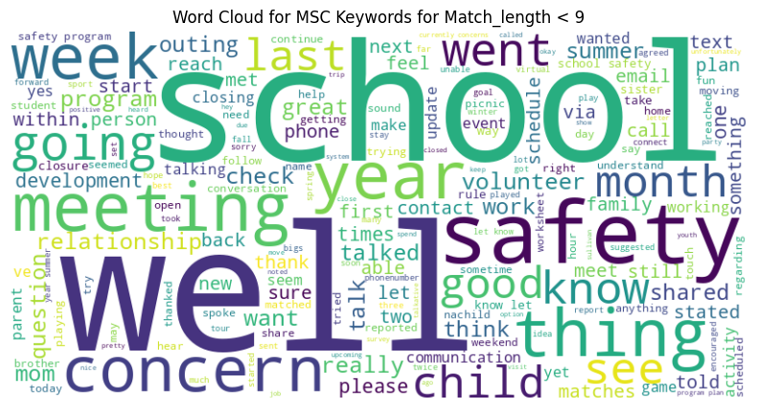
Word Cloud
Word Cloud for Successful Match Keywords
Word Cloud for MSC Keywords for Match Length < 9
Notes:
Devendra For the word clouds, this is not a precise model. However, it does give us a good insight into the match notes for successful and unsuccessful matches. For example, the fact that the word "time" shows up more frequently in successful matches is likely because the volunteer and child/family are looking farther into the future. Words like "concern" and "safety" comes more often in matches with shorter length.
Script:
We built word clouds from support call notes to understand keywords in successful vs unsuccessful matches. Even though this is an abstract model, it does give us a good insights for example words like “time” appear more in successful matches, hinting at future planning. In contrast, words like “concern” and “safety” are more frequent in shorter matches, signaling issues in the match.

Slide 18
04
Predictive Model
Notes:
Devendra

Slide 19
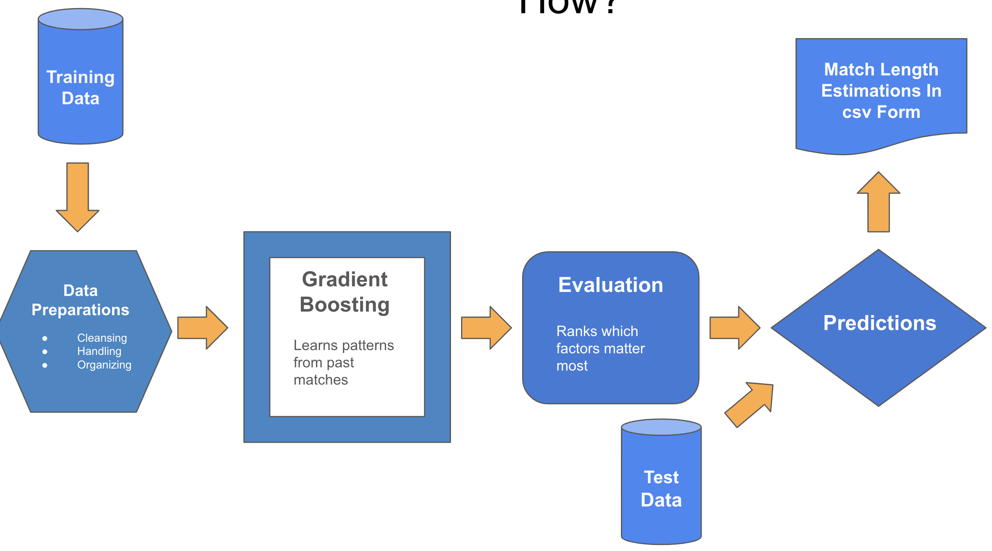
Prediction Model
- Predicts how long matches will last
- Gradient boosting model
- Handles mixed data types well
- Strong with non-linear relationships
- Relatively robust to outliers
- Interpretable Insights
- Efficient
Notes:
Devendra
Script:
Now. let's dive into prediction model we used to predict match length.
For match length prediction, we cleaned the data, trained a gradient boosting model, validated it, and then predicted on test data. We chose this model because it handles mixed data, captures non-linear patterns, is robust to outliers, and performs efficiently.

Slide 20
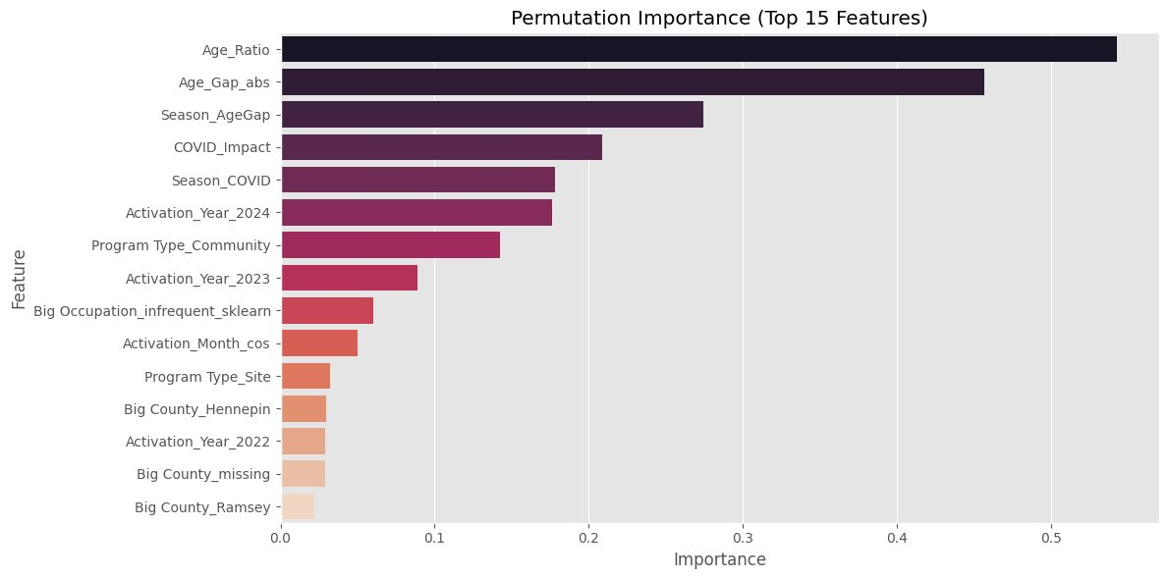
Model Performance
Age gap, seasonality, and program type disproportionately affect match length.
Performed 62% better than naïve median based model
Provided consistent results
Notes:
Wyatt

Slide 21
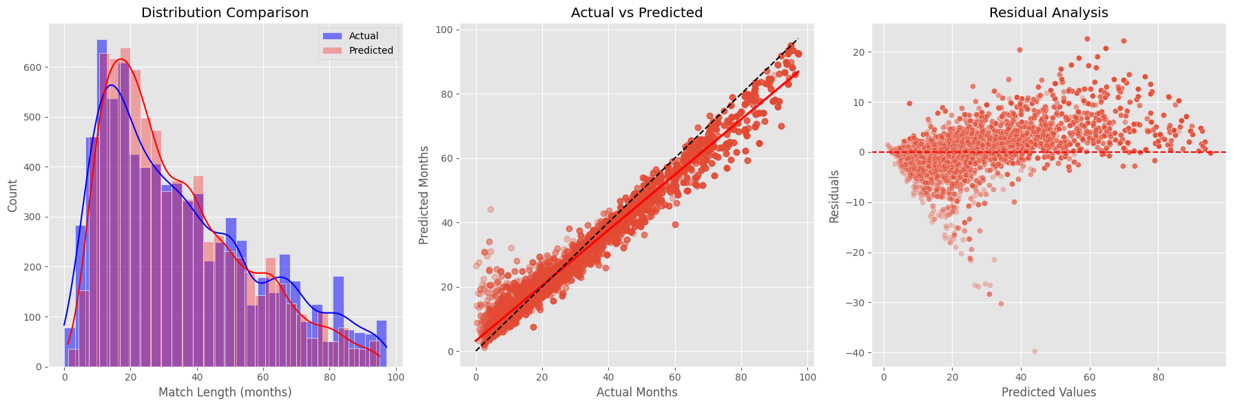
Model Performance Cont.
RMSE: 5.15
Notes:
Wyatt

Slide 22
05
Intervention Strategies
Notes:
S

Slide 23
Questionnaire
7 emotions
Feelings about important features mentioned (age gap, season)
Major life changes

Slide 24
Thank You!
Metric Masters

Slide 25
APPENDIX

Slide 26
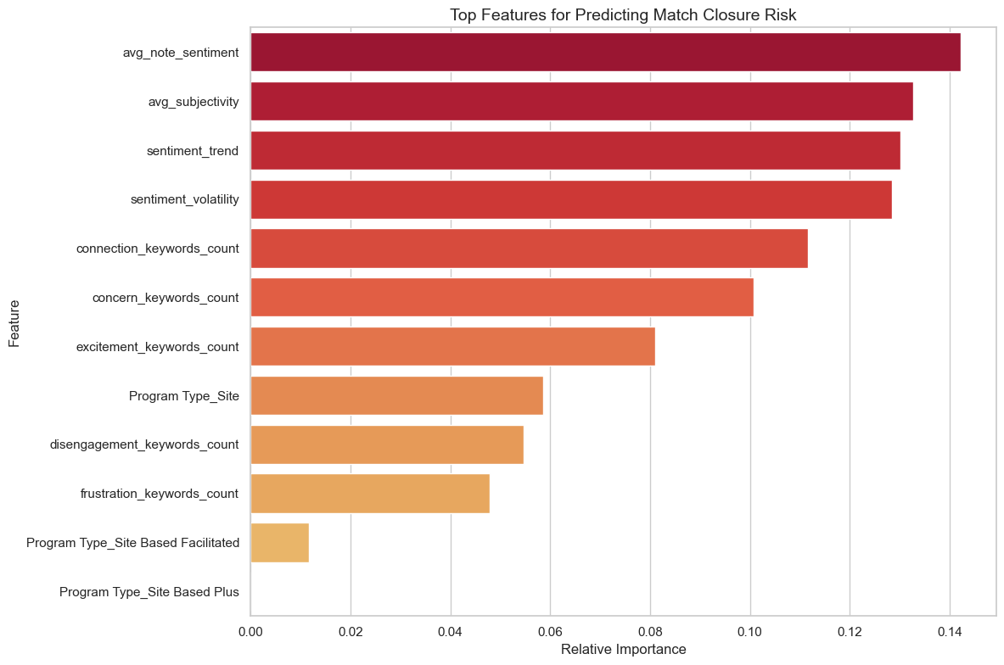
Top Features for Predicting Match Closure Risk

Slide 27
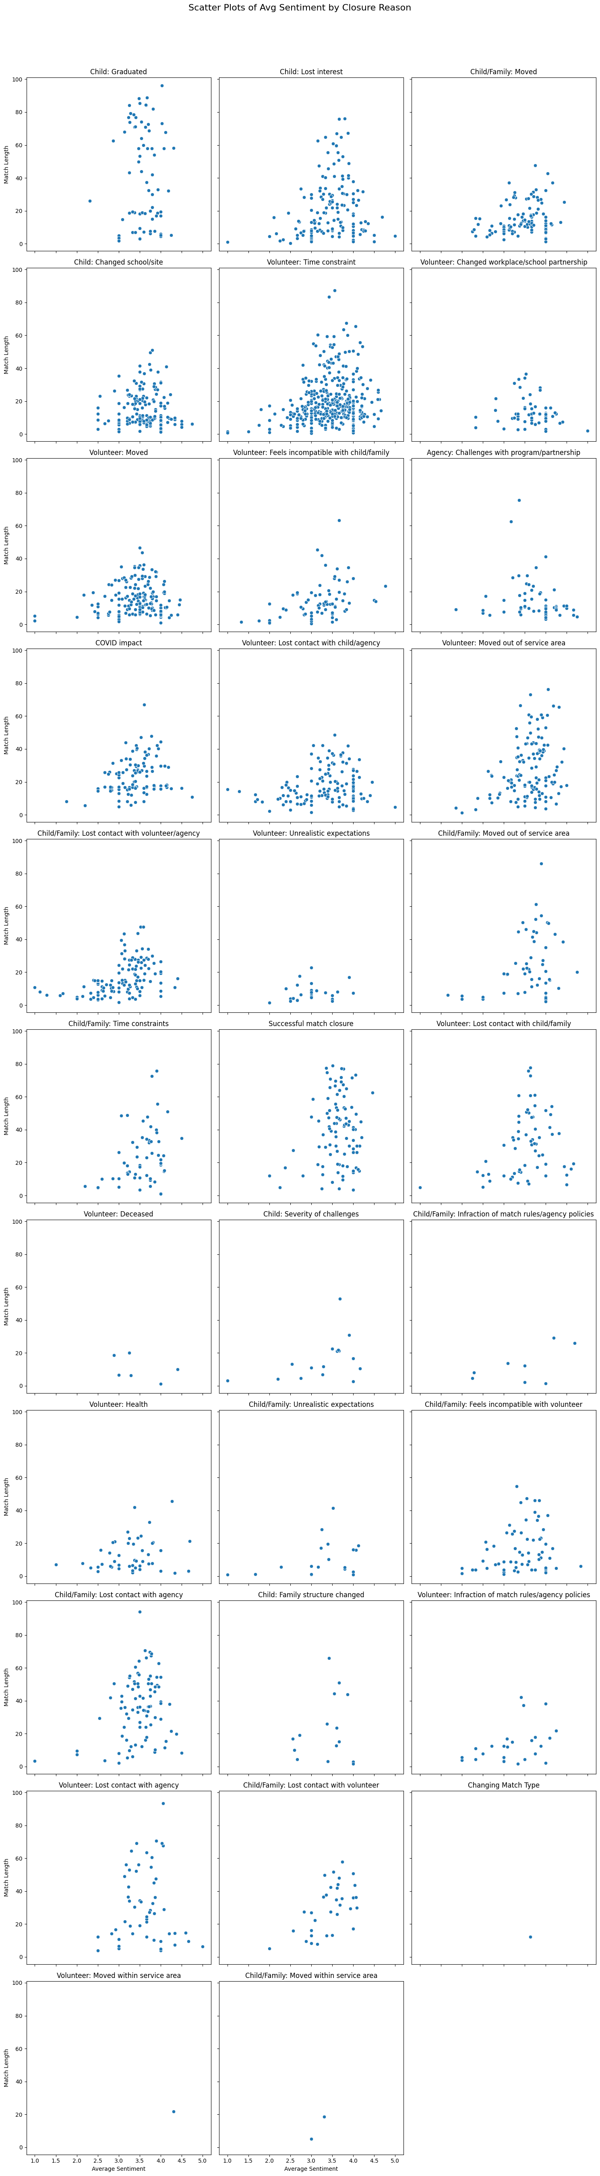
Closure Reasons
Notes:
Child graduated
Child lost interest
Child moved
Family moved
Child changed school
Child changed site
Volunteer time constraint
Volunteer changed workplace
volunteer changed school partnership

Slide 28
Closure Reasons Cont.
Notes:
Volunteer moved
Volunteer feels incompatible with child
Volunteer feels incompatible with family
Agency challenges with program
Agency challenges with partnership
COVID impact
Volunteer lost contact with child
Volunteer lost contact with agency
Volunteer moved out of service area

Slide 29
Closure Reasons Cont.
Notes:
Child lost contact with volunteer
Child lost contact with agency
Family lost contact with volunteer
Family lost contact with agency
Volunteer unrealistic expectations
Child moved out of service area
Family moved out of service area
Child time constraints
Family time constraints
Successful match closure
Volunteer lost contact with child
Volunteer lost contact with family

Slide 30
Closure Reasons Cont.
Notes:
Volunteer deceased
Child severity of challenges
Child infraction of match rules
Child infraction of agency policies
Family infraction of match rules
Family infraction of agency policies
Volunteer health
Child unrealistic expectations
Family unrealistic expectations
Child feels incompatible with volunteer
Family feels incompatible with volunteer

Slide 31
Closure Reasons Cont.
Notes:
Child lost contact with agency
Family lost contact with agency
Child family structure changed
Volunteer infraction of match rules
Volunteer infraction of agency policies
Volunteer lost contact with agency
Child lost contact with volunteer
Family lost contact with volunteer
Changing match type

Slide 32
Closure Reasons Cont.
Notes:
Volunteer moved within service area
Child moved within service area
Family moved within service area

Slide 33
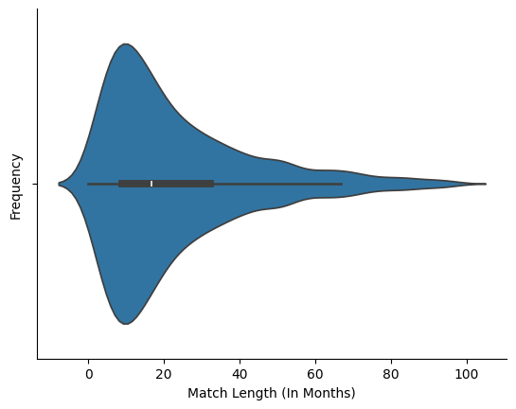
Match Length Distribution

Slide 34
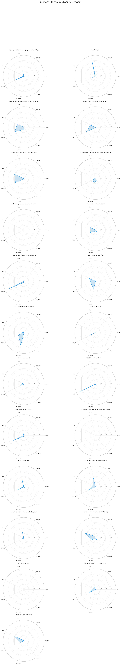
Emotional Tone by Closure Reason
Notes:
Agency challenges with program
Agency challenges with partnership
COVID impact
Child feels incompatible with volunteer
Family feels incompatible with volunteer
Child lost contact with agency
Family lost contact with agency

Slide 35
Emotional Tone by Closure Reason Cont.
Notes:
Child lost contact with volunteer
Family lost contact with volunteer
Child lost contact with volunteer
Family lost contact with volunteer
Child lost contact with agency
Family lost contact with agency
Child moved out of service area
Family moved out of service area
Child time constraints
Family time constraints

Slide 36
Emotional Tone by Closure Reason Cont.
Notes:
Child unrealistic expectations
Family unrealistic expectations
Child changed school
Child changed site
Child family structure changed
Child graduated

Slide 37
Emotional Tone by Closure Reason Cont.
Notes:
Child lost interest
Child severity of challenges
Successful match closure
Volunteer feels incompatible with child
Volunteer feels incompatible with family

Slide 38
Emotional Tone by Closure Reason Cont.
Notes:
Volunteer health
Volunteer lost contact with agency
Volunteer lost contact with child
Volunteer lost contact with agency
Volunteer lost contact with child
Volunteer lost contact with family

Slide 39
Emotional Tone by Closure Reason Cont.
Notes:
Volunteer moved
Volunteer moved out of service area
Volunteer time constraint

Slide 40
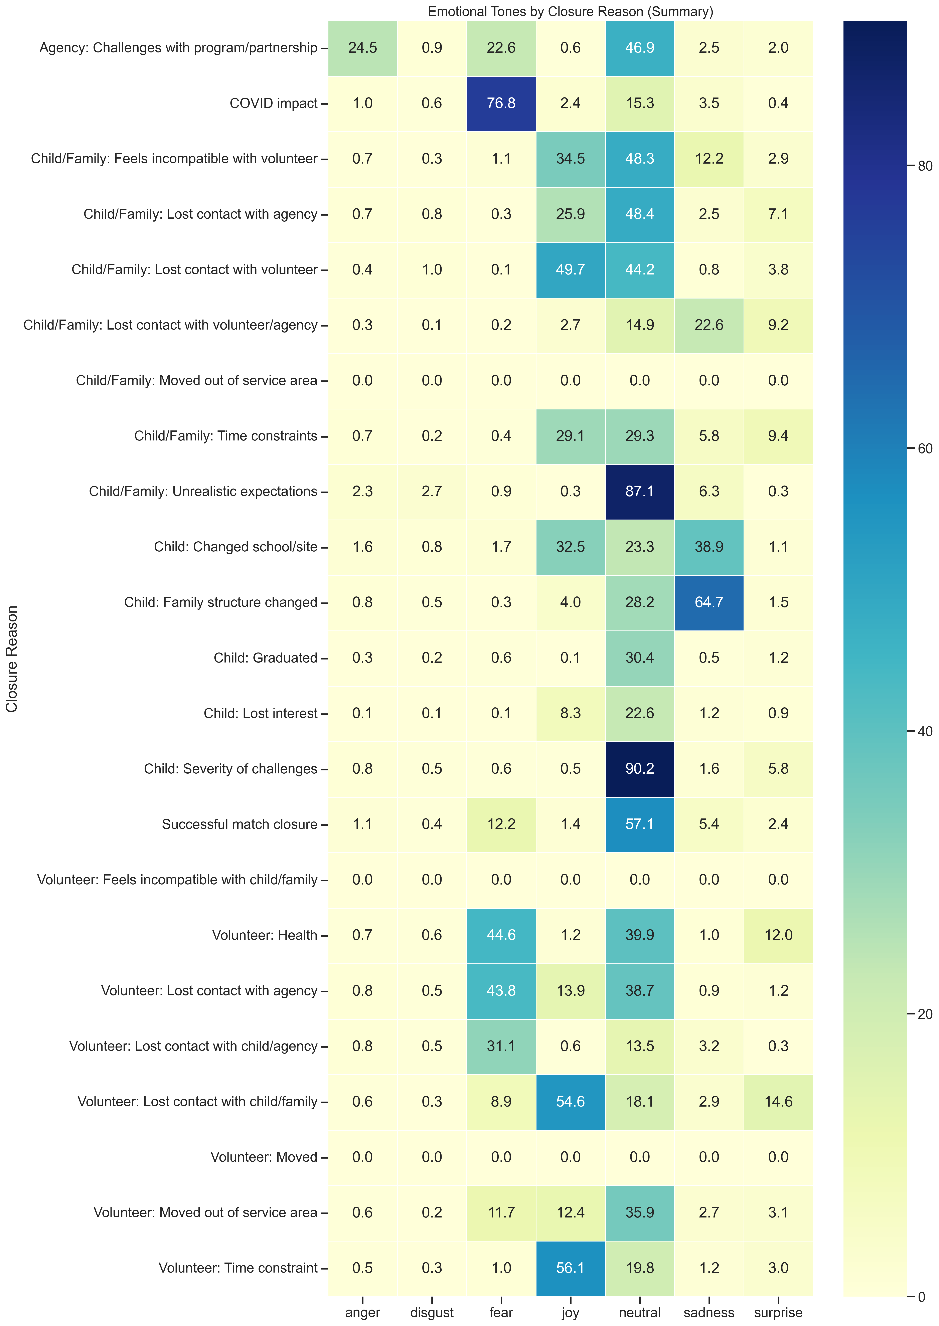
Emotional Tones by Closure Reason

Slide 41
Emotional Tones by Closure Reason

Slide 42
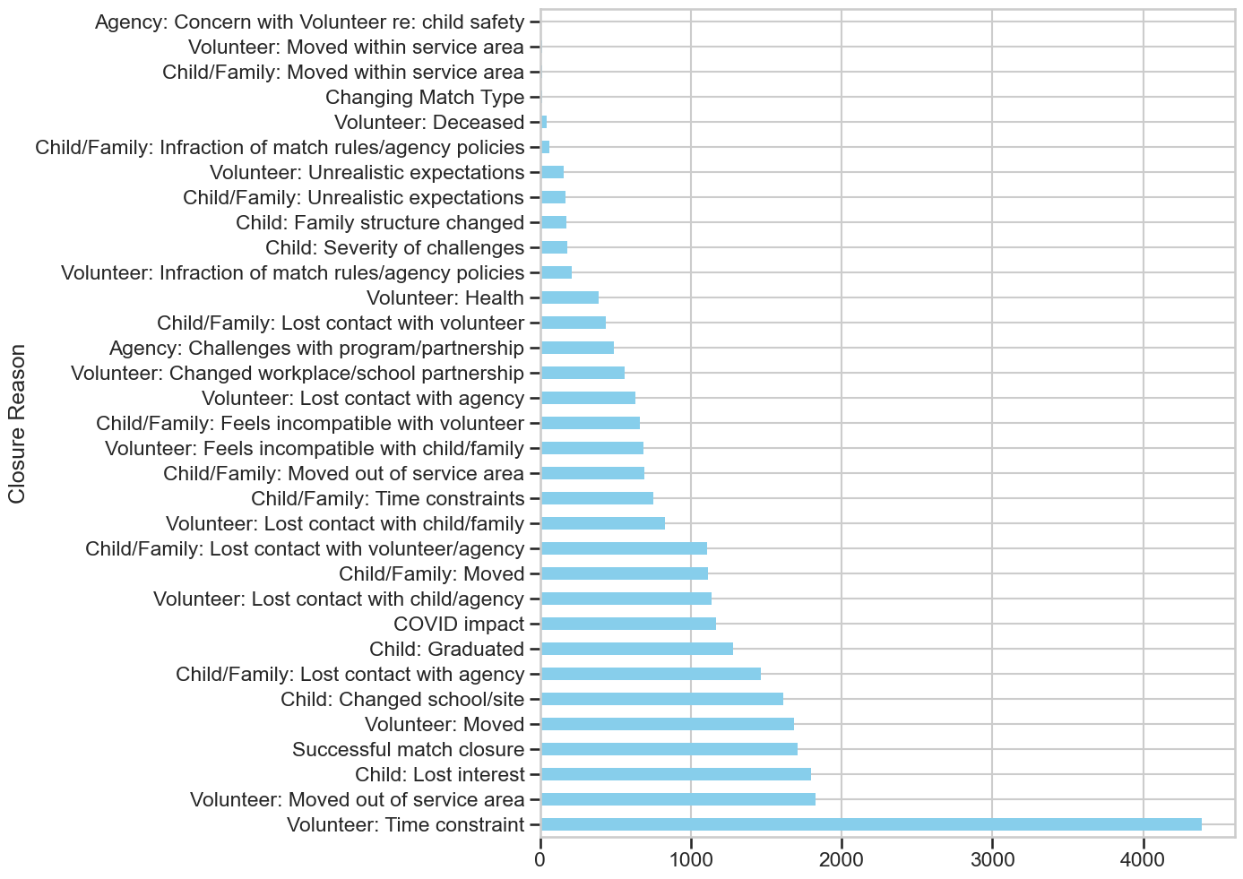
Frequency of Closure Reasons

Slide 43
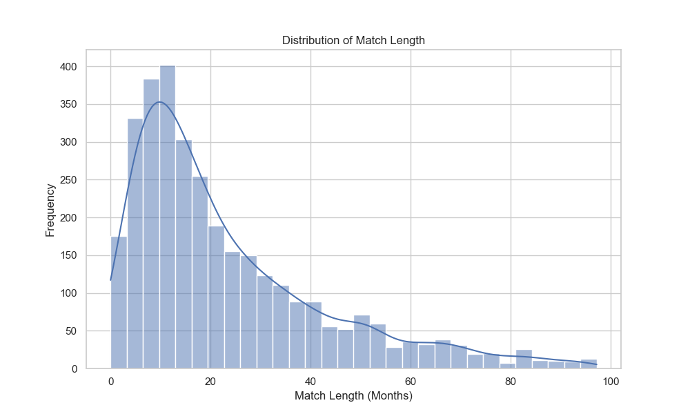
Distribution of Match length

Slide 44
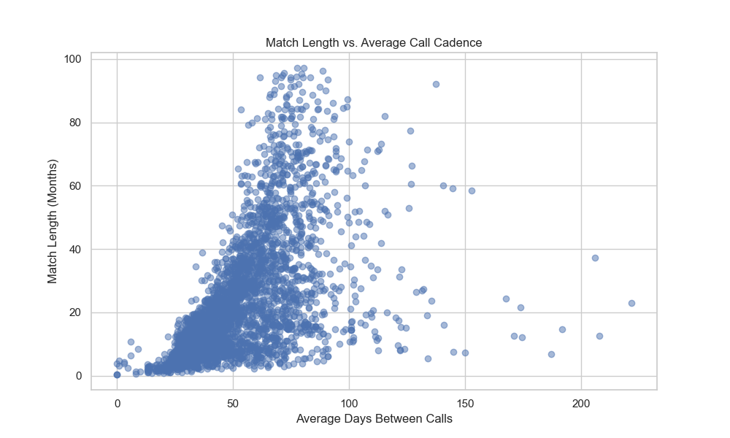
Match Length vs. Average Call Cadence

Slide 45
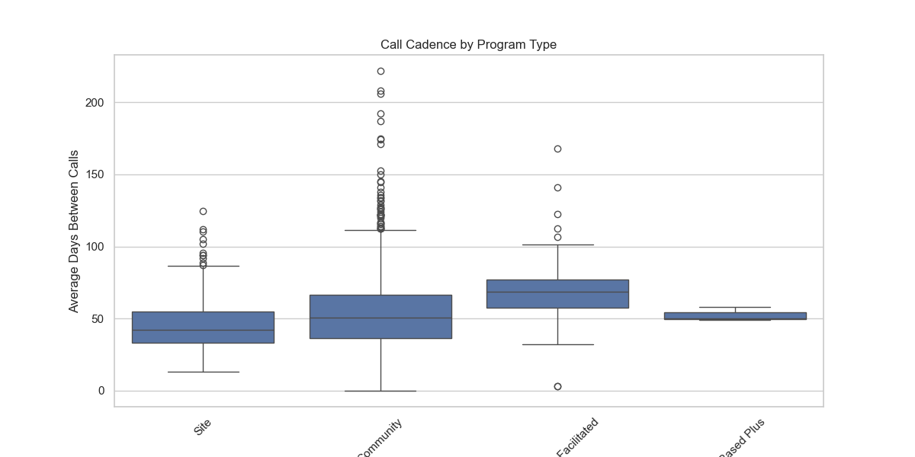
Call Cadence by Program Type

